Slide 1
Blocks, Procs and lamdas
Herman Langner

Slide 2
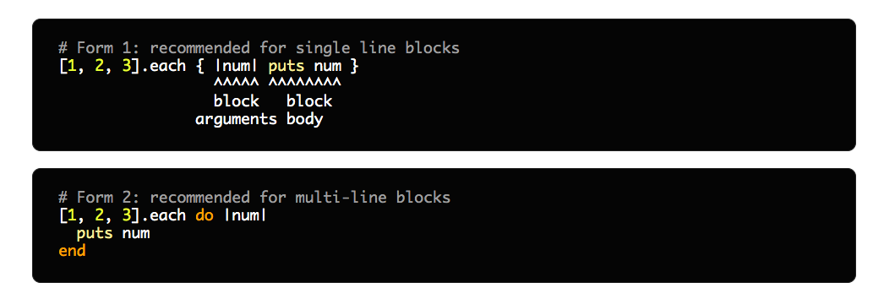
Blocks
Blocks are anonymous functions that can be passed into methods.
Denoted by do/end after function parameters or {} for single lines
Notes:
The first portion of this presentation is mostly a verbatim copy of https://www.rubyguides.com/2016/02/ruby-procs-and-lambdas/

Slide 3
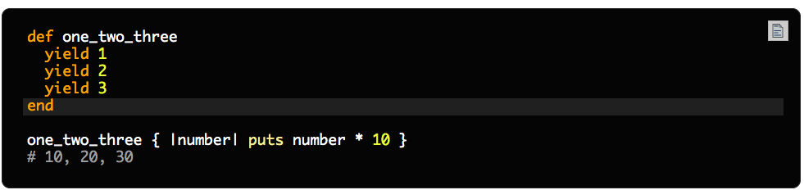
Blocks
Blocks can be either called implicitly or explicitly
To call implicitly we rely on the keyword `yield<params(0...many)>`
Params are optional (i.e. there’s no validation on it)
Yield can be called multiple times
Jumps to method call to execute block

Slide 4
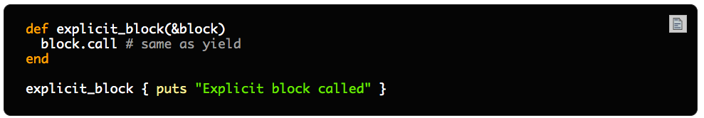
Blocks
Explicit blocks are just procs in disguise
Explicit blocks are specified in the input params of the function but still called like a block
In the background get transformed into a proc
Notes:
As its name suggests it enables you to perform "online" i.e non-blocking schema changes to your database, hopefully without your users noticing.

Slide 5
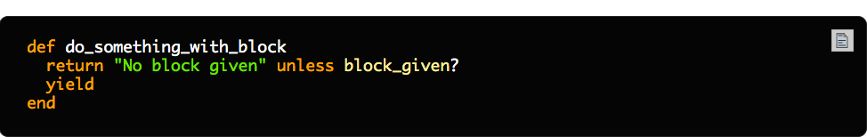
Blocks
When blocks are optional in the method we can check for their existence using a `block_given?`

Slide 6
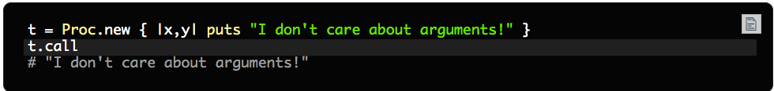
Procs
Are essentially blocks that can be stored as variables
Does not validate whether parameters are passed through

Slide 7
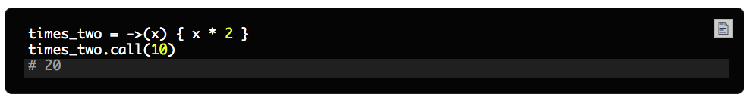
Lambdas
A special type of proc
Requires parameters to be passed through on the proc.call or it exceptions out
(has a different behaviour to return more on that in proc vs lamdas)

Slide 8
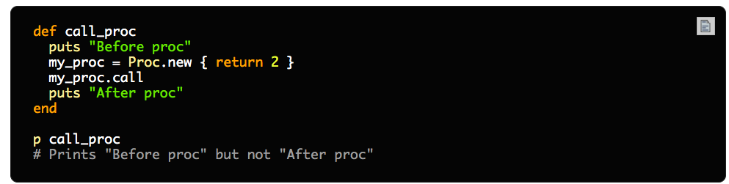
Procs vs lamdas
Procs
When you call return, it will return from the current scope
Can lead to odd exceptions
Notes:
To be able to support emojis, we needed to convert every VARCHAR column in every component of the pipeline to utf8mb4.
For the following apps:
Reports
Data Collector
Store
We managed to perform the following changes with zero downtime:
Convert every table to a newer file format called Barracuda.
Modify every VARCHAR column to support utf8mb4.

Slide 9
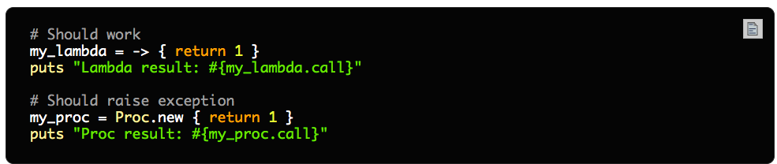
Procs vs lamdas
lamdas
When you call return, it returns exactly like a method
Notes:
To be able to support emojis, we needed to convert every VARCHAR column in every component of the pipeline to utf8mb4.
For the following apps:
Reports
Data Collector
Store
We managed to perform the following changes with zero downtime:
Convert every table to a newer file format called Barracuda.
Modify every VARCHAR column to support utf8mb4.

Slide 10
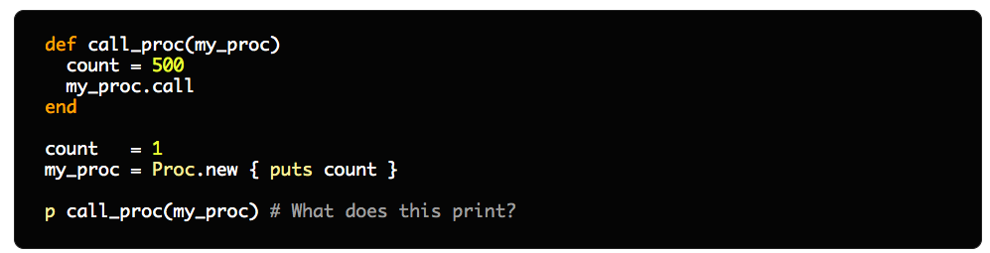
Procs vs lamdas
Closures
Procs and lamdas capture context from the point of where they are defined. And will use the variable context at that point and not local variables unless it’s passed as a parameter
In the background achieved by making use of the binding class that captures context

Slide 11
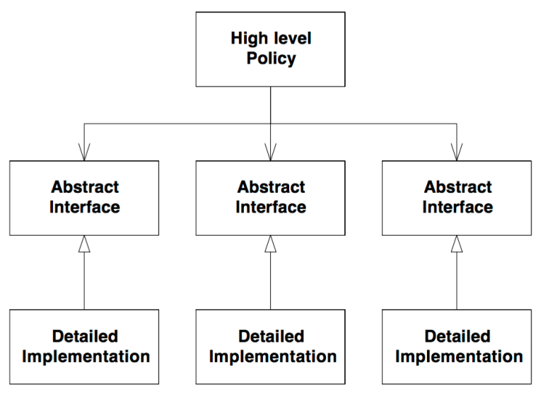
Dependency inversion
One of the two most important parts of the SOLID principles
We use it everyday
Critical when breaking down apps and knowing what to test

Slide 12
Why for this kata?
It has many interesting uses of functions and lamdas
Safest topic that might not be broadly covered
Dips into other topics (specs and dependency injection)
It’s where people start getting excited over functional programming

Slide 13
Composition over inheritence
Lamdas and procs are the gateway drug to functional programming
There’s a camp that believes that classes have a more modular design when composed where inheritence is concrete (and is usually a victim of leaky abstractions)
Definition: Composition over inheritance (or composite reuse principle) in object-oriented programming (OOP) is the principle that classes should achieve polymorphic behavior and code reuse by their composition (by containing instances of other classes that implement the desired functionality) rather than inheritance from a base or parent class.[2] This is an often-stated principle of OOP, such as in the influential book Design Patterns.[3]

Slide 14
Let’s have some fun

